Slide 1
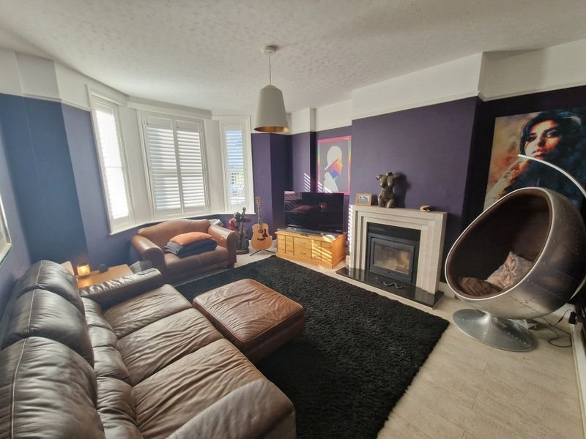
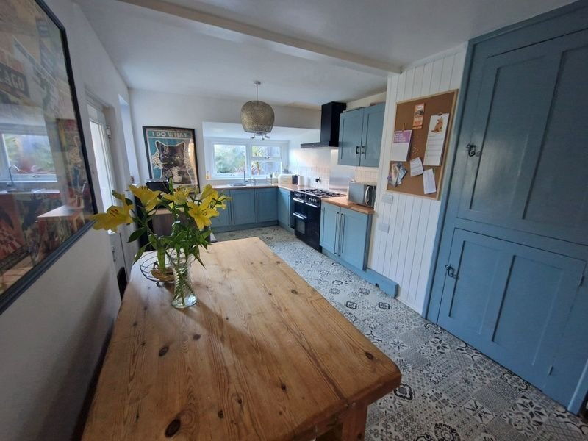
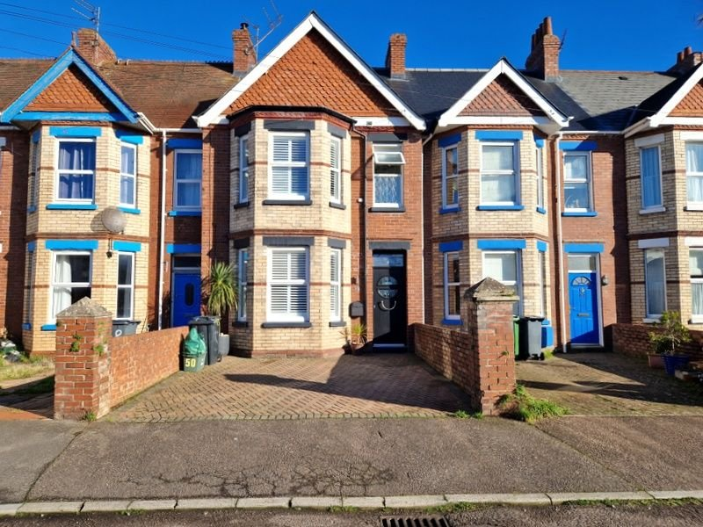
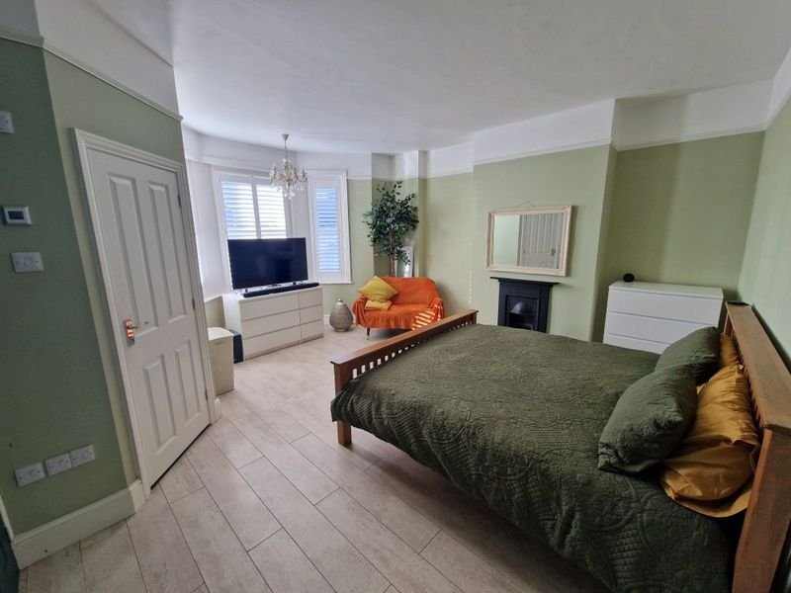
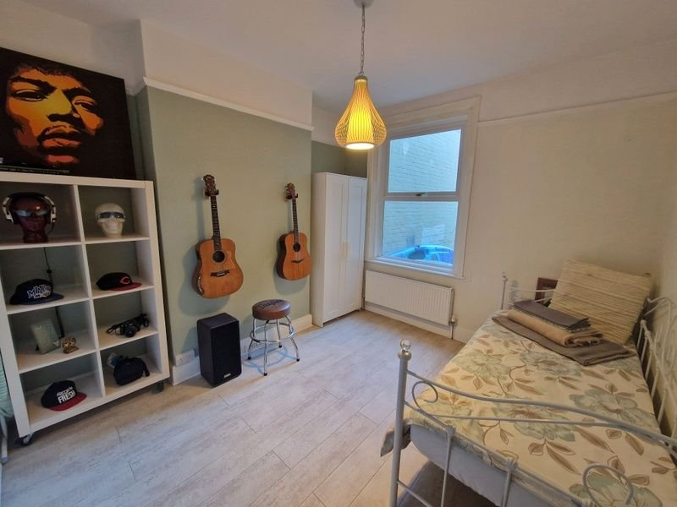
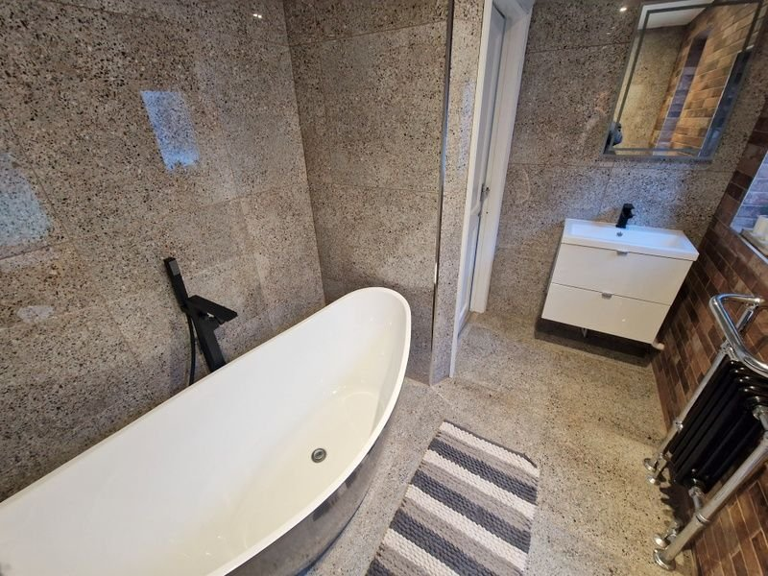
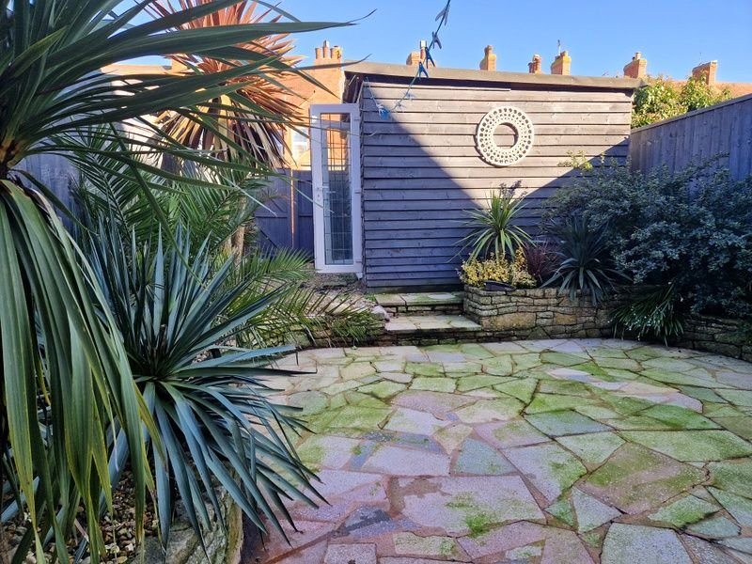
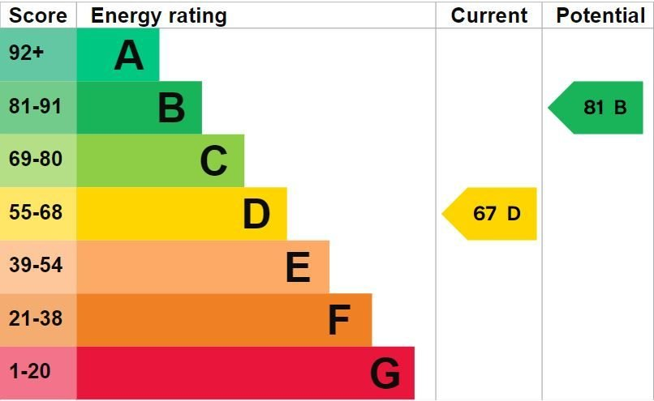
www.pennys.net
50 Lyndhurst Road, Exmouth, EX8 3DT
GUIDE PRICE £420,000
TENURE Freehold
An Exceptional Bay Fronted Period Terraced House Ideally Located Close To Amenities With Off-Road Parking And Attractive Enclosed Rear Garden
Bay Windowed Lounge With Wood Burner Stove • Dining Room/Bedroom Four •
Open Plan Kitchen/Dining Room • Three First Floor Bedrooms – Main Bedroom With En-Suite Shower Room/WC • Stunning Bathroom Suite •
Newly Replaced Roof • Gas Central Heating • Double Glazed Windows •
Wonderful Family Home •
Pennys Estate Agents Limited for themselves and for the vendor of this property whose agents they are give notice that:- (1) These particulars do not constitute any part of an offer or a contract. (2) All statements contained in these particulars are made without responsibility on the part of Pennys Estate Agents Limited. (3) None of the statements contained in these particulars are to be relied upon as a statement or representation of fact. (4) Any intending purchaser must satisfy himself/herself by inspection or otherwise as to the correctness of each of the statements contained in these particulars. (5) The vendor does not make or give and neither do Pennys Estate Agents Limited nor any person in their employment has any authority to make or give any representation or warranty whatever in relation to this property.
PENNYS ESTATE AGENTS
2 Rolle House, Rolle Street, Exmouth, Devon, EX8 2SN
Tel: 01395 264111 EMail: help@pennys.net

Slide 2
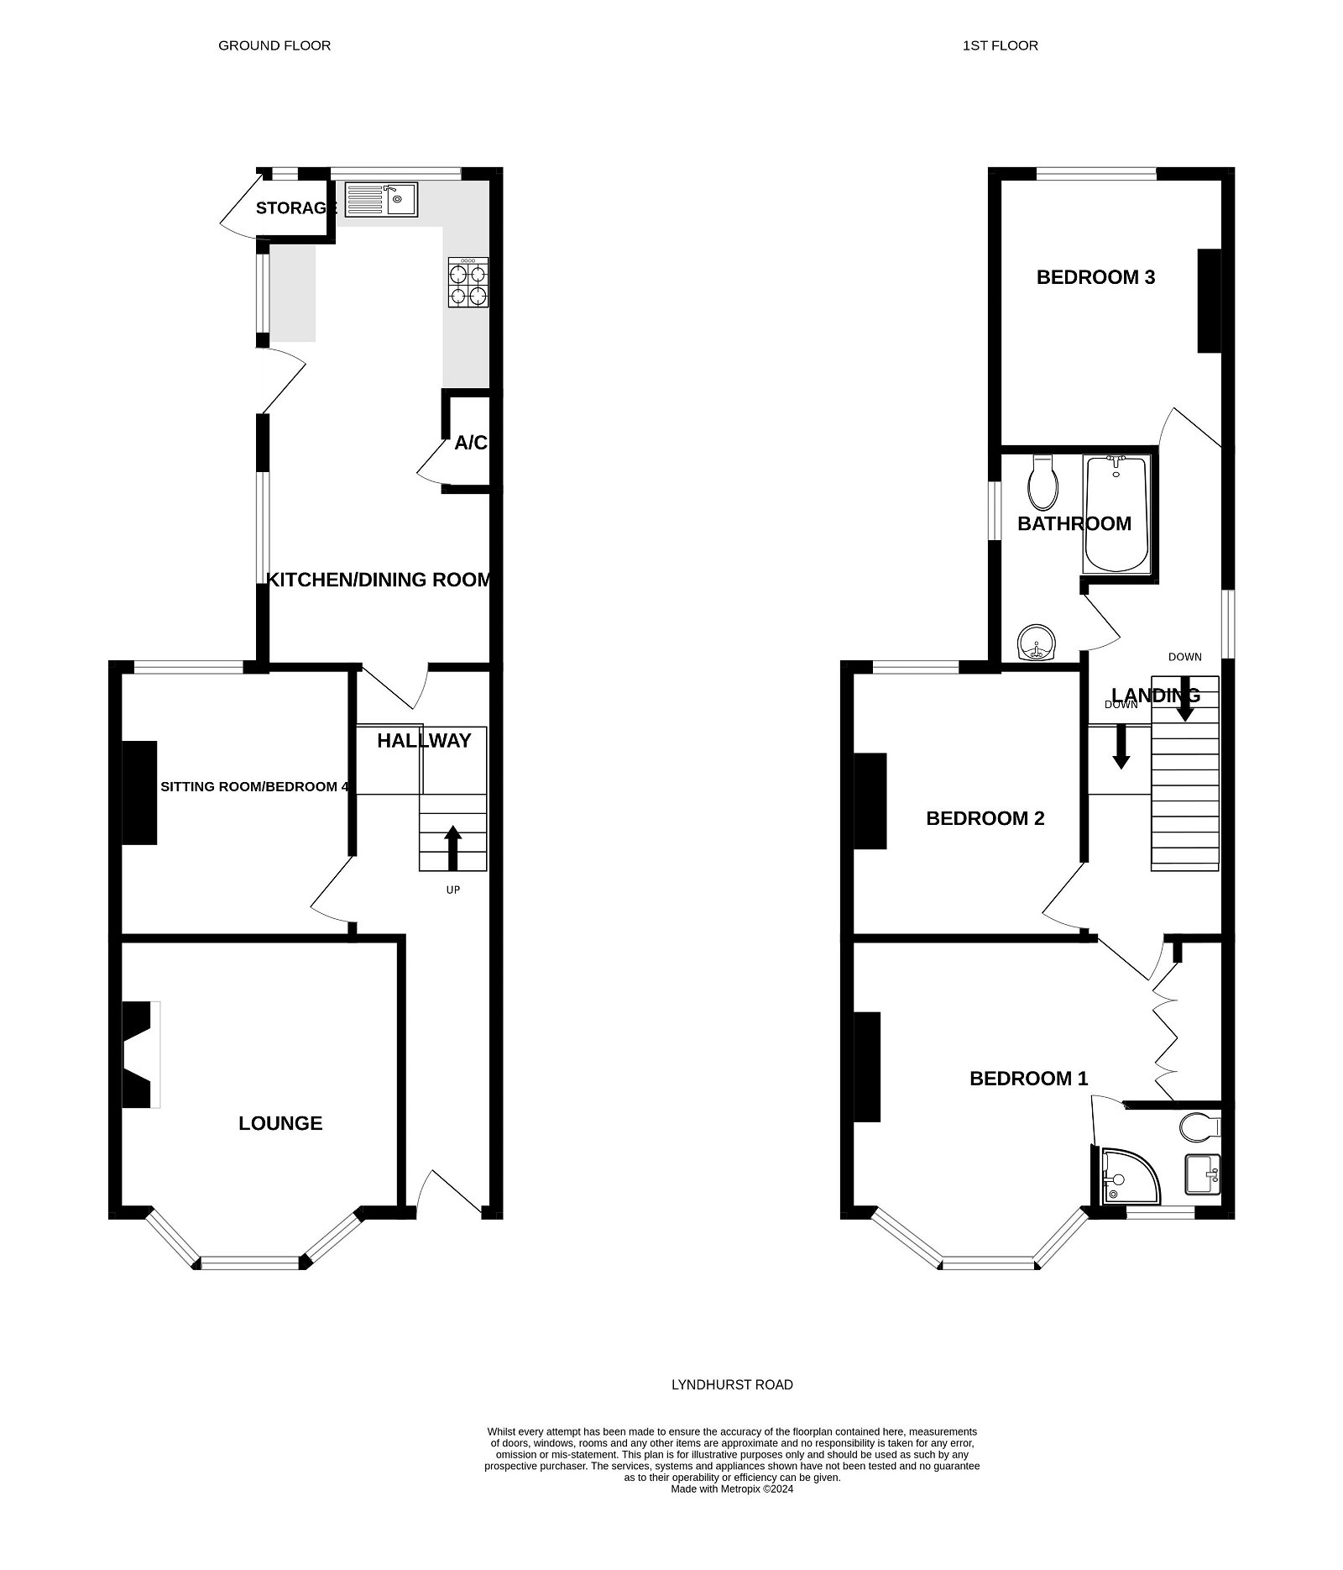
50 Lyndhurst Road, Exmouth, EX8 3DT
THE ACCOMMODATION COMPRISES: Composite front door with pattern window inset to: ENTRANCE VESTIBULE: Feature mosaic tiled flooring; wood tongue and groove wall to dado rail; opening through to: RECEPTION HALL: Radiator housed in feature radiator cover; stairs to first floor landing; feature wood flooring. LOUNGE: 5.08m x 4.09m (16'8" x 13'5") A charming room with measurement into uPVC double glazed bay window to the front aspect with wooden window shutters; log burner stove housed in stone fire surround with marble hearth; wood effect flooring; radiator; television point; picture rail. SITTING ROOM/BEDROOM FOUR: 3.28m x 3.51m (10'9" x 11'6") A versatile room with wood effect flooring; radiator; picture rail; uPVC double glazed window to rear aspect. KITCHEN/DINING ROOM: 7.92m x 3m (26'0" x 9'10") Narrowing at one end to 7'0" (2.13m) A spacious room with wood effect worktop surfaces with cupboards and drawer units beneath; tiled surrounds; inset single drainer sink unit with swan neck mixer tap; Belling oven with stainless steel back and chimney style extractor hood over; fitted wooden cupboards; larder style cupboard; space for upright fridge freezer; uPVC double glazed windows to side and rear aspects; uPVC double glazed door to outside. FIRST FLOOR LANDING: uPVC double glazed window to side aspect with pattern glass; access to roof space via loft ladder; doors to: BEDROOM ONE: 5.08m x 3.48m (16'8" x 11'5") into double glazed bay window to front aspect with fitted wooden window shutters; feature fireplace with tiled hearth; wood effect flooring; picture rail; built-in wardrobes with cupboards over; radiator. EN-SUITE SHOWER ROOM/WC: 1.52m x 1.52m (5'0" x 5'0") Stylishly fitted with shower cubicle; contemporary style wash hand basin with drawer unit beneath and mirror over with integrated light over; WC with concealed cistern and push button flush; tiled and heated floor; tiled walls to picture rail; recess ceiling LED lighting; uPVC double glazed window with pattern glass; ceiling extractor fan. BEDROOM TWO: 3.53m x 3.28m (11'7" x 10'9") uPVC double glazed window to rear aspect; radiator; picture rail; chimney recess with shelf. BEDROOM THREE: 3.71m x 3.07m (12'2" x 10'1") uPVC double glazed window to rear aspect; radiator; picture rail. BATHROOM/WC: 2.67m x 2.01m (8'9" x 6'7") A truly stunning bathroom suite with freestanding bath with floor mounted taps with shower attachment; contemporary style wash hand basin with mirror with integrated light over and drawer units beneath; WC with push button flush; antique style radiator with heated towel rail attached; tiled walls with feature exposed brick wall; two uPVC double glazed windows with pattern glass; tiled and heated floor; extractor fan.
OUTSIDE: A block paved parking area to the front. There is an attractive enclosed rear garden paved with raised shrub beds; access to UTILITIES CUPBOARD with plumbing for an automatic washing machine and housing Ideal gas boiler. LOG CABIN 3.94m x 2.87m (12'11" x 9'5") with uPVC double glazed double doors. Pedestrian gate to service lane; outside light.
FLOOR PLAN:

